Slide 1
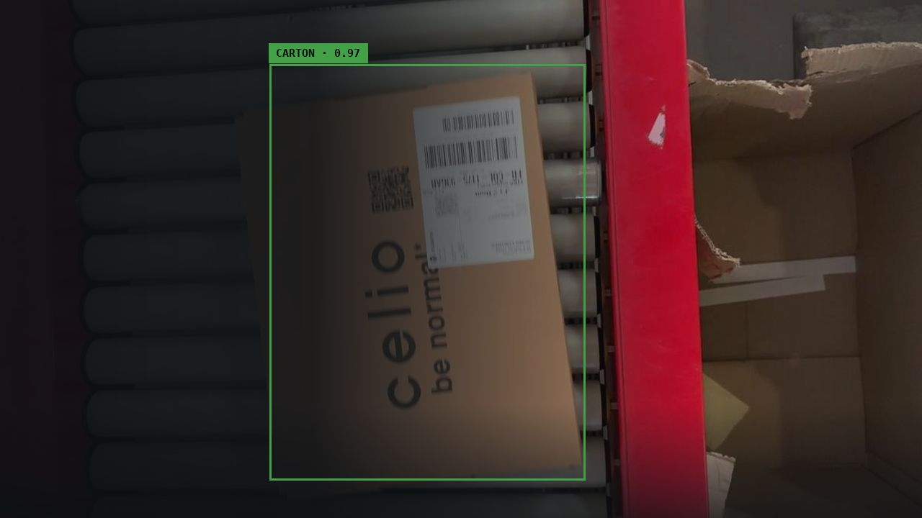

IsiDetector
Automated Parcel Detection
& Sorting Assistance
ATANDA Abdullahi
COMPUTER VISION / AI
01 / 05

Slide 2
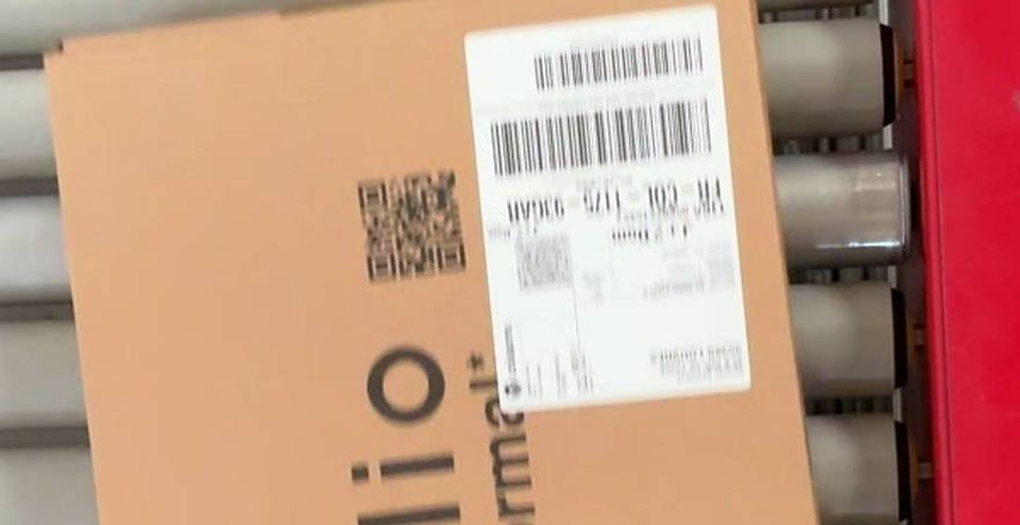
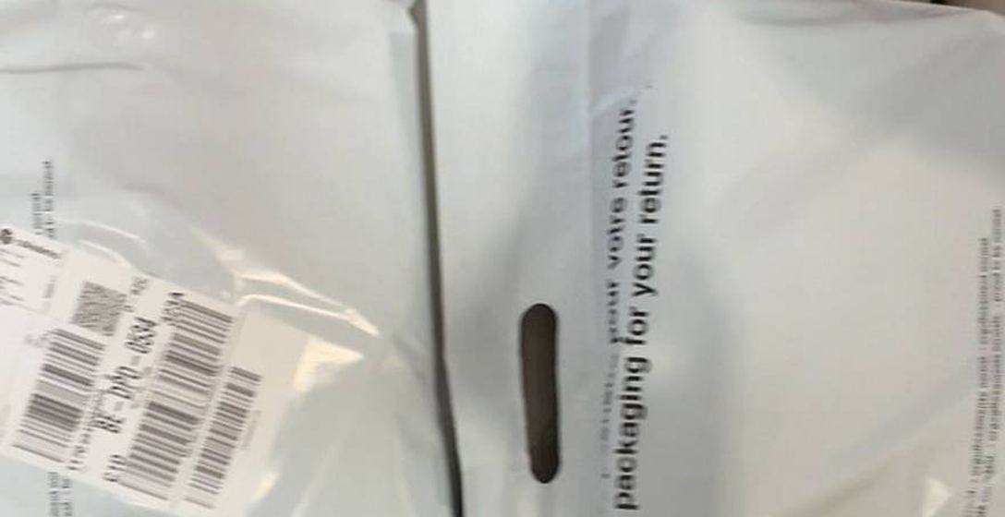
THE CHALLENGE
02 / 05
When the barcode can't be read
~2% of parcels become difficult to process
GOOD
Barcode clearly visible
DIFFICULT
Folded · damaged · hidden · face-down

Slide 3
THE SOLUTION
03 / 05
A second pair of eyes
CAMERA
ISIDETECTOR
SORTER
Detect · Track · Count
UDP / RELAY
your existing IP camera
your machine, in charge
Works alongside your existing system
No change to the barcode chain
One clear signal per parcel

Slide 4
THE PROOF
04 / 05
Measured. Tested. Ready to demonstrate.
>95%
1×
Identification
One parcel → one event
<15 ms
N days
p95 trigger latency
Continuous operation

Slide 5
OPERATIONAL CONFIDENCE
05 / 05
Built for continuous operation
SELF-DIAGNOSIS
TRACEABILITY
RESILIENCE
SUPPORT
Know when something goes wrong
Every event is recorded
Automatic recovery
Remote assistance

Slide 6
DEMO
06 / 06

